Slide 1
CONNECT 4
Valentin Cudey & Pierre Abril

Slide 2
Summary
Requirement/ Analysis
Black-box testing
Design
Implementation
Testing

Slide 3

Requirement/ Analysis (Week 2)
Software Requirements
Journal:
Family and friend game
2 player turn per turn
Easy access

Slide 4
Black-box testing
Test ID | Description | Expected Results | Actual Results
1 | Testing valid inputs with an empty column | The token should be at the bottom of the column | As Expected
2 | Testing valid entries with a partially filled column | The token should be just above the highest token in that same column | As Expected
3 | Test valid inputs with a full column | There will be an error message and the player will have to play in another location | As Expected
4 | Test with a column that does not exist | The player will have to play elsewhere. | As Expected
5 | Test to place a token on a column | The token will be present on this same column according to the first 3 tests | As Expected
6 | Victory test | If a player has 4 of these tokens lined up, he wins | As Expected
7 | Equality test | If the grid is full then there is a tie | As Expected

Slide 5
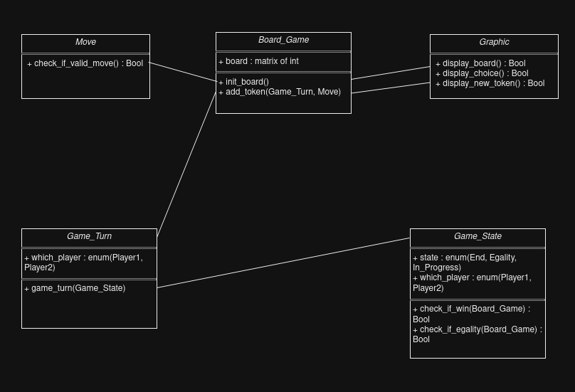
Design
Journal:
Nouns
Classes
Attributes
Verbs
Methods
Software Design

Slide 6
Implementation
Programming Concept
Variables
Classes
Methods
Programming language:
Python: simple graphical interface management (Pygame)
JavaScript: Good if web-based Connect4
C++: More speed but harder than Python

Slide 7
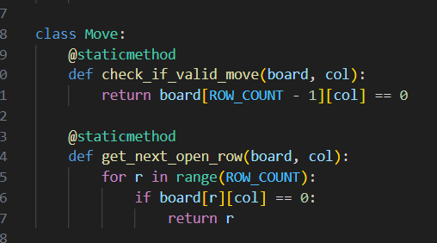
Testing Example of classes
Journal:
Board Game
Game turn
Game state
Move
Graphic
Testing Details

Slide 8

Simple demo

Slide 9
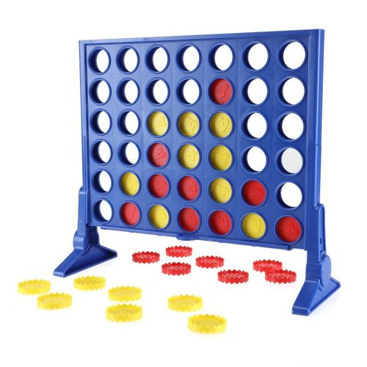
Thanks you for listening !

